Slide 1

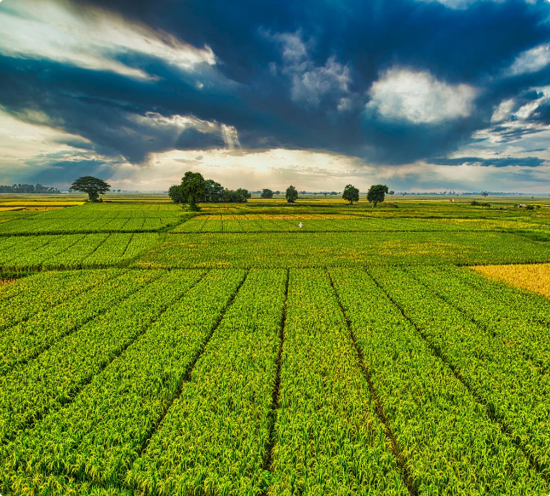
Crop Production Analysis
This report provides an in-depth analysis of crop production data to identify opportunities for increasing yields and optimizing resources. The presentation covers key insights from two interactive dashboards, as well as a conclusion with recommendations for boosting crop production.

Slide 2
Attributes Used:
1
State Name
2
District Name
33 Different states of India including union territories are covered in this dataset
646 districts of the given states are utilised in drawing analysis.
3
Crop Year
4
Season
Crop year from 1995 to 2015 is given.
6 Crop seasons such as Kharif, Rabi, Whole year, summer, winter, autumn is used in dataset.
5
Crop
6
Area
Different types of regional crops such as wheat, maize, coconut, Bajra, Groundnut etc is given.
Area in terms of hectares is given. Total area utilised is 2.95 bn.
7
Production
8
Production per unit Area
Production in metric tons is given. Total crop production is 141.18 bn.
It is a derived attribute derived from production and area.

Slide 3
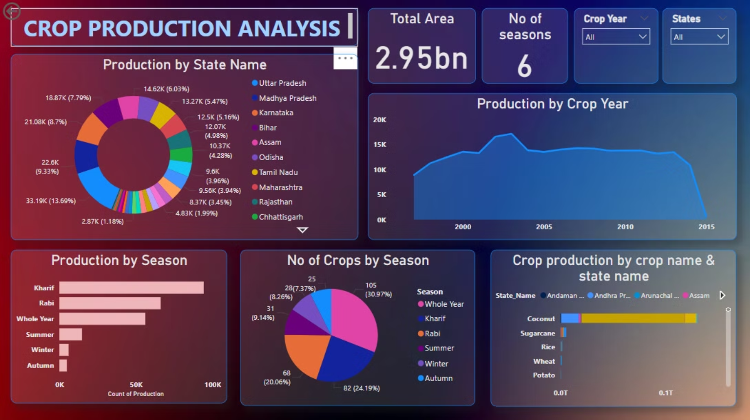

Slide 4
Conclusion of Dashboard 1
1
Production by State
2
Production by Area
3
Production by Season
UttarPradesh has the count of crop production followed by Madhya Pradesh and Karnataka. Least production is in Chandigarh.
There is a significant curve between year 2000-2005 and a steady decline from year 2010-2015. Highest crop production is noticed in the year 2003.
Kharif season seems to be the most productive season, followed by Whole year and Rabi . Crop production is the lowest in Autumn.
4
No of crops by Season
5
Crop Production by crop name and State Name
Maximum no of crops are grown throughout the year, followed by Kharif and Rabi season. In the whole year 105 types of distinct crops are grown in different states.
Different crops are grown in different states . Eg: Kerala has the maximum production of coconut followed by Andhra Pradesh. Also Sugrcane production is highest in Uttar Pradesh.

Slide 5
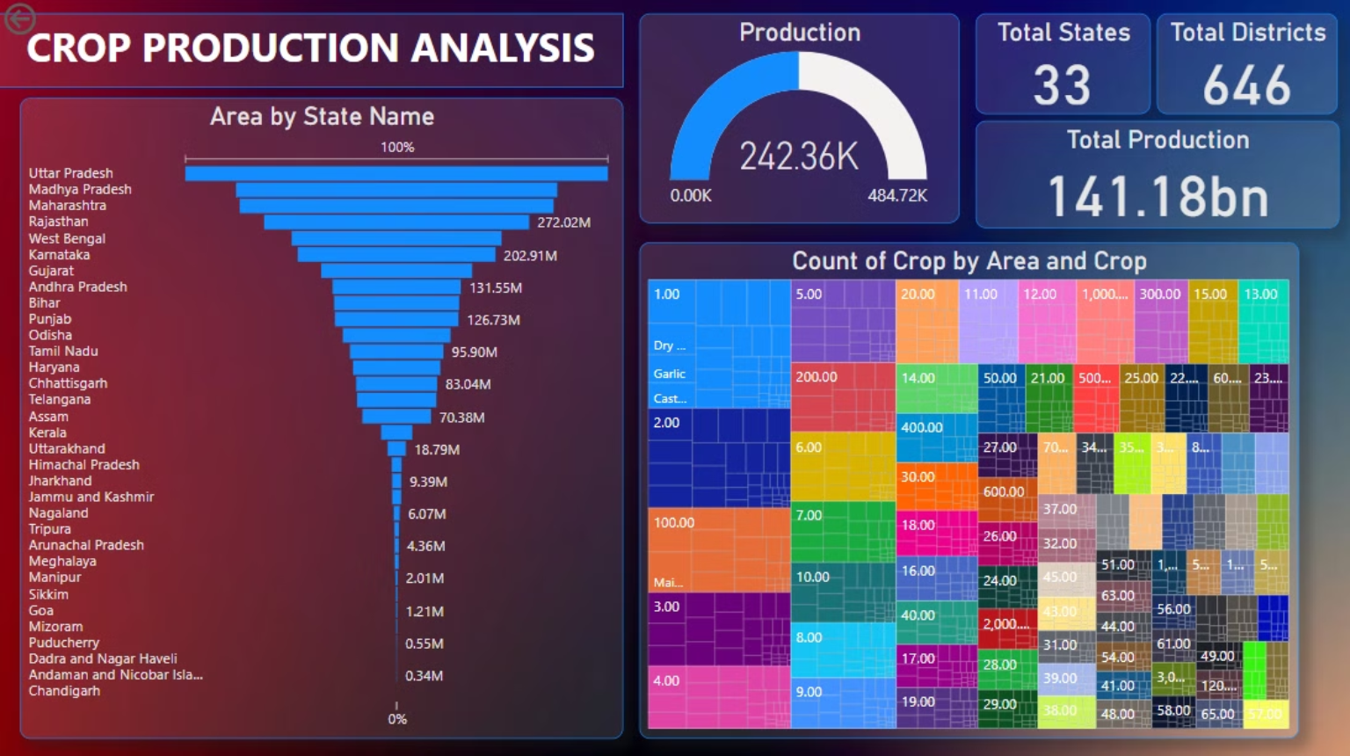

Slide 6
Conclusion of Dashboard 2
Area by State Name
Count of crop by Area and crop Name
Uttar Pradesh has the highest area for crop production followed by Madhya Pradesh and Maharashtra. Least area is covered by Chandigarh.
The Tree graph shows the Count of crops along with the area occupied by that crop. For example, 212 crops of Maize can be cultivated in 1 hectare of land.

Slide 7

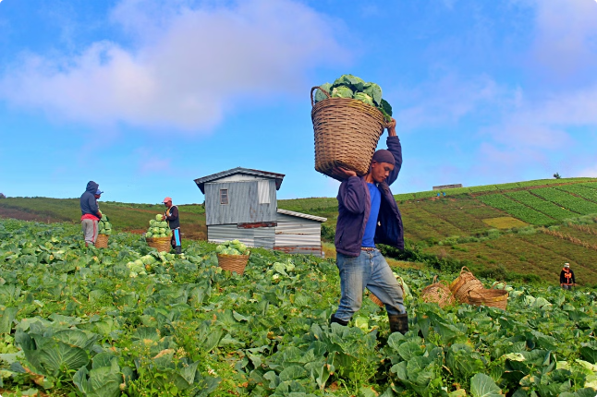
Conclusion for Increasing Crop Production
Data-Driven Insights
Maximum Cultivation must be done in Kharif season so that crop production gets maximized. Also Pressure must be given on growing seasonal and regional crops. Regions having lesser area must focus on increasing their land. Crops having least production should be focused and measures must be taken for them.

Slide 8



Next Steps
Training Programs
Stakeholder Collaboration
Targeted Investments
Provide hands-on training to farmers on the adoption of data-driven, sustainable farming practices.
Foster partnerships between farmers, researchers, and policymakers to drive coordinated action.
Allocate resources towards technology, infrastructure, and research to support long-term productivity gains.

